Slide 1
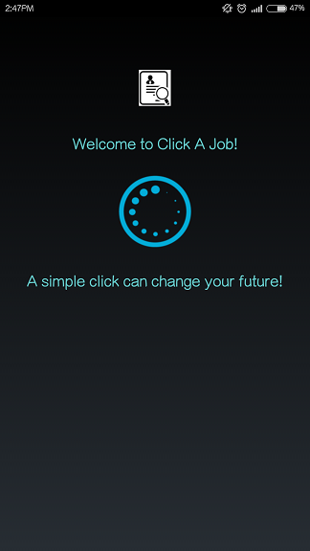
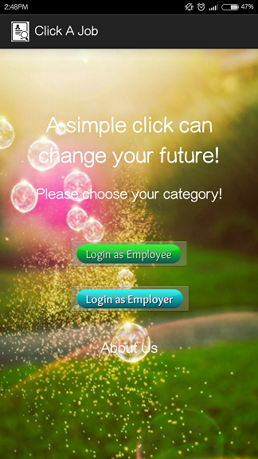
CLICK A JOB RECRUITMENT SYSTEM BASED ANDROID MOBILE APPS
PRESENTED BY Koo Sheng Kuan (168225)
SUPERVISOR
Assoc. Prof. Dr. Zuriati Binti Zulkarnain
EVALUATOR
Dr. Azizol Bin Hj Abdullah
SKR 4999 FINAL YEAR PROJECT

Slide 2
OUTLINE
Introduction
Problem Statement
Objectives
Literature Reviews
Methodology
System Analysis & Design
Results & Discussions
Future Works & Conclusion

Slide 3
INTRODUCTION
Nowadays smartphone, tablet, and other smart devices are transforming the way people live, work, play, connect and interact
Mostly mobile applications are Android based and it helps many people on many ways.
A simple click can change your future!
Employment and income mean a lifestyle with value, choice and empowerment.
It is important because human tends to change for a better lifestyle.
In this technology era, is a trend to search vacancy thru mobile devices and apply for job at your fingertips.

Slide 4
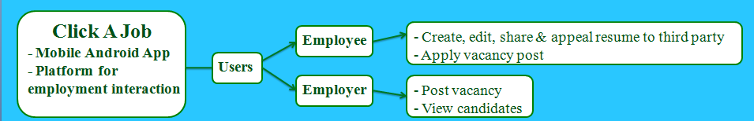
INTRODUCTION (Click A Job)
Curriculam Vitae (CV) = overview of a person's experience and qualifications.
Resume = document used by persons to present their backgrounds and skills.
CV is longer and more detailed while resume is a shorter, summary version
Both can be used for a variety of reasons, but most often they are used to secure new employment.
For example, university student need CV for their internship and job application to show personal details, working history, education background and qualification.

Slide 5
PROBLEM STATEMENT
Mobile user having difficulty on low mobility on other devices.
Users might not get used to the standard CV or resume formats
The existed system is not applicable for the users to submit CV or resume.
Other system interface is not specified designed for mobile user. It is not convenient and not user-friendly. This also make less efficient in recruitment.
There might be expensive cost to purchase this kind of mobile application.

Slide 6
OBJECTIVE
Produce a good quality and useful CV or resume editor application that is convenient and easy to be use by the users.
Develop a system that allows users to create, edit, share CV or resume and apply for job at anytime and anywhere easily through their mobile devices.
Allow users(employee) to submit and appeal their CV or resumes to third party and apply for the vacancy; Allow users(employer) to post their vacancy and view candidate so that the employment will be easier.
Develop a mobile apps that emphasis on interface design specific to mobile users.
A free mobile application without any charges.

Slide 7
LITERATURE REVIEW
Android Operating System
a mobile operating system (OS) currently developed by Google, based on the Linux kernel and designed primarily for touchscreen mobile devices
open source mobile development platform
According to International Data Corporation (IDC) report about smartphone OS market share 2015, Android dominated the market with an 82.8% share

Slide 8
LITERATURE REVIEW
Unemployment Issues In Malaysia
Unemployment is an important issue facing in many developing countries. Country with high unemployment indicates that the country’s labour resource is not fully utilized.
Malaysia can be said to achieve full employment with unemployment rate of 3.1 % in February 2015 by Department of Statistics.
However, unemployment among graduates remains unsolved, where 65,500 graduates were recorded unemployed which is 16.7 % of the total unemployed labour in 2010 based on Department of Statistics, Malaysia.
the rate of unemployment in Malaysia decreased throughout the year, the number of unemployed graduate in Malaysia increased.

Slide 9

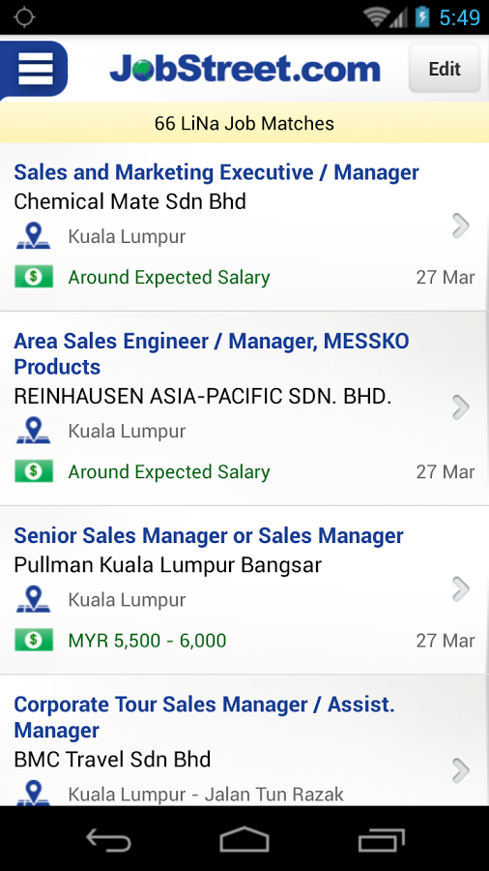
LITERATURE REVIEW
Existing relevant applications
1. JobStreet
- Advantages:
Large talent pool – partner nationwide
It is now Southeast Asia's largest online
employment company
Can search and look for interesting jobs
-Disadvantages:
It enable user to view and apply a vacancy
without a proper resume or either using one.
Some vacancy can only be applied via website.
It provides insufficient detail from the company
(For example, salary, working location and job scope).

Slide 10
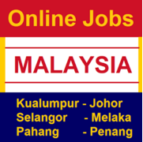
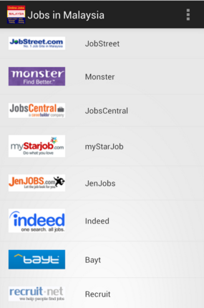
LITERATURE REVIEW
Existing relevant applications
2. Jobs In Malaysia
- Advantages:
It is a portal for job seeker to search for
vacancies
Assemble many vacancies from different
employment website
-Disadvantages:
Does not offer the option such as creating
a resume.
It has insufficient details from the portal
on how to apply and where to apply.
Not applicable for user to submit resume.

Slide 11

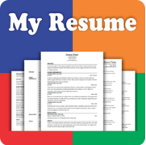

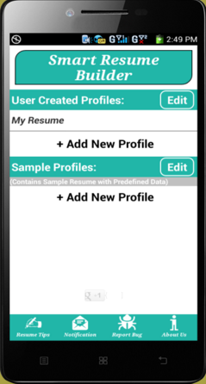
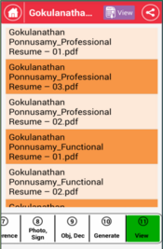
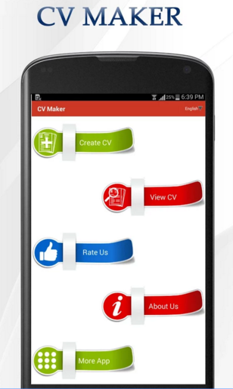
LITERATURE REVIEW
Existing relevant applications
3. CVmaker/Smart Resume Builder/My Resume builder
- Advantages:
Good resume builder with several formats
Can generate resume in pdf form
- Disadvantages:
Offers service solely on
creating resume.
There is no recruitment service
Not applicable to submit resume.

Slide 12
OUTLINE
Introduction
Problem Statement
Objectives
Literature Reviews
Methodology
System Analysis & Design
Results & Discussions
Conclusion & Future Works

Slide 13
METHODOLOGY
Requirement Specification
WATERFALL MODEL
System Design
Design Implementation
Verification and Testing
System Development
Software Maintenance

Slide 14
METHODOLOGY
Popular system development life cycle model
Linear and sequential development method
Divides development processes into several phases
Strict mode, no overlapping steps

Slide 15
HARDWARE REQUIREMENT
Asus A55V(Intel i5-3210 processor, 4 GB RAM, 64-bit Operating System)
Smartphones with minimum Android 4.0
Xiaomi 3(Quad core 2.3GHz, 2 GB RAM, Android v4.4)

Slide 16


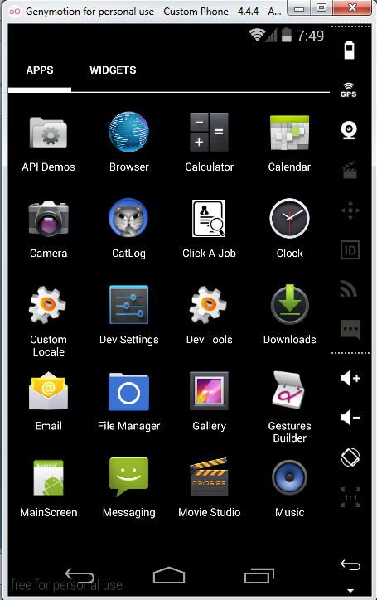
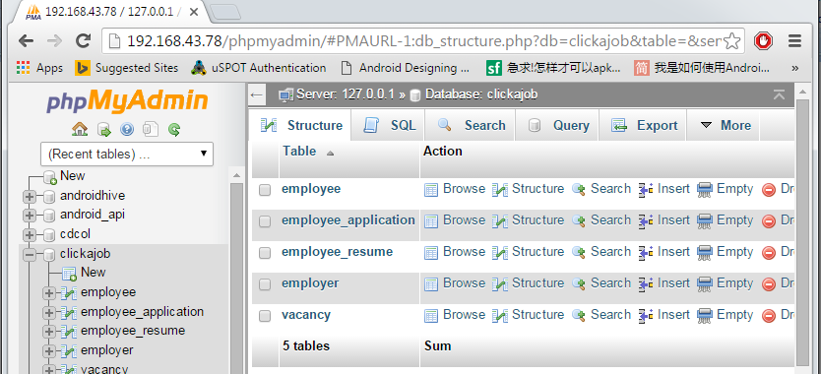
SOFTWARE REQUIREMENT
Android Developer Tools v22.2.1
Android 4.4 platform SDK
Emulator(Virtual device) with Android 4.4 (KitKat) SDK
Genymotion emulator
XAMPP

Slide 17
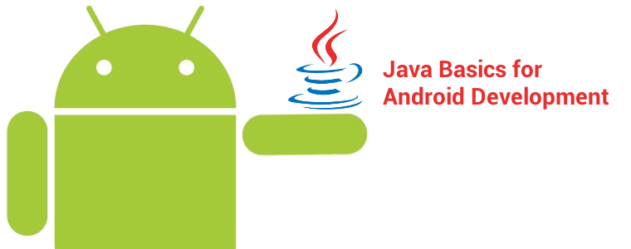
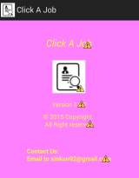
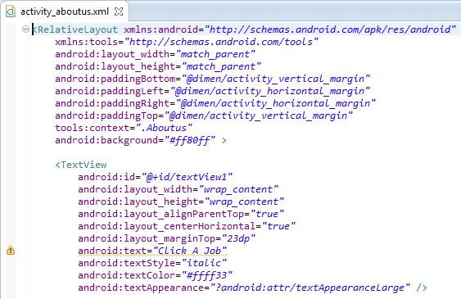
PROGRAMMING LANGUAGE
JAVA programming language
Extensible Markup Language (XML)

Slide 18
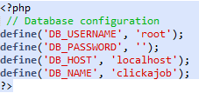
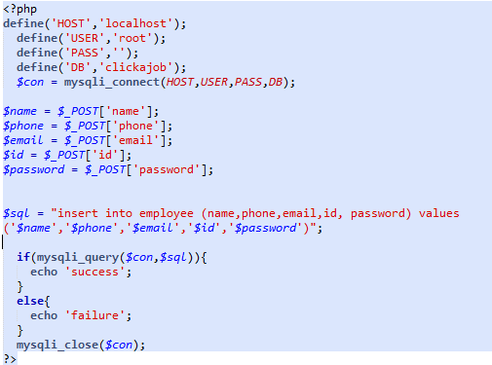
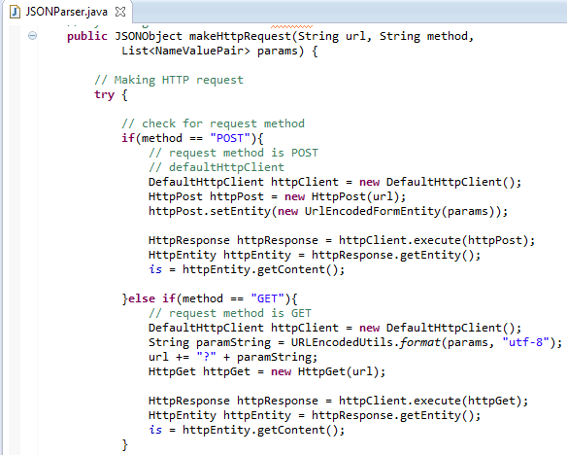
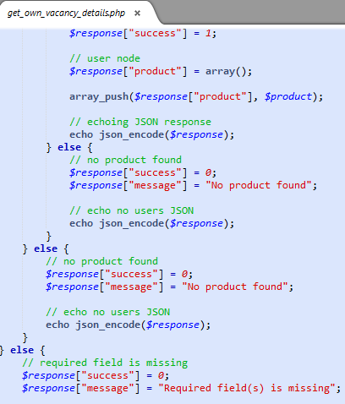
PROGRAMMING LANGUAGE
PHP
JavaScript Object Notation (JSON)

Slide 19
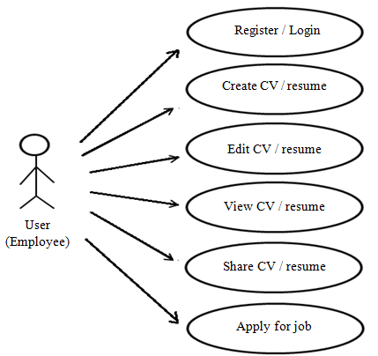
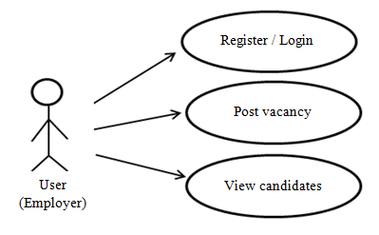
SYSTEM ANALYSIS AND DESIGN Use Case Diagram

Slide 20
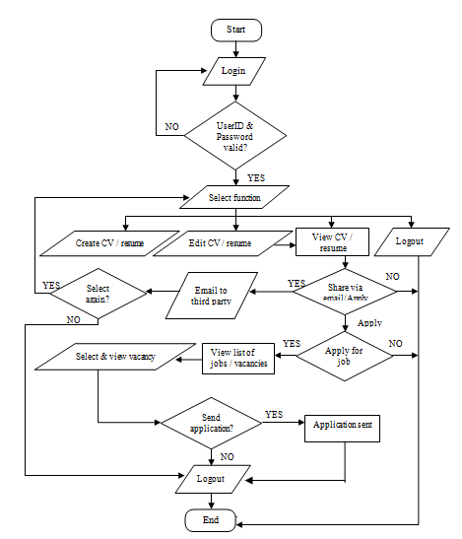
FLOWCHART (EMPLOYEE)

Slide 21
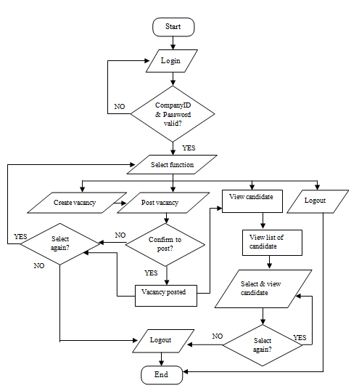
FLOWCHART (EMPLOYER)

Slide 22
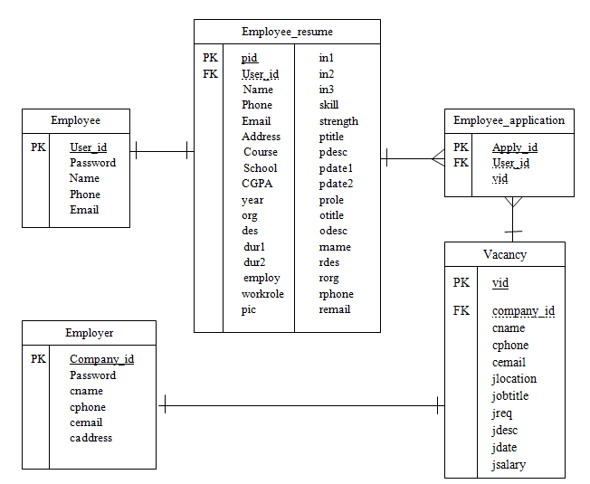
Entity Relationship (ER) Diagram

Slide 23
OUTLINE
Introduction
Problem Statement
Objectives
Literature Reviews
Methodology
System Analysis & design
Results & Discussions
Conclusion & Future Works

Slide 24

RESULT

Slide 25
DISCUSSION
Advantages of this application:
Minimum configuration is required
Assure a quality and useful platform for employment
Convenient and easy recruitment
Free mobile apps
Emphasis on interface design for mobile user
Allow user to submit and appeal CV/ resume

Slide 26
DISCUSSION
Limitations:
Recently only one standard format of resume is available
Resume or vacancy information cannot be downloaded or printed
Users can view each other’s resume or vacancy only, but they can’t communicate
Solutions:
Adding more resume formats
Adding feature to download and print the information of resume or vacancy (connect to the website)
Adding feature that connect both employee and employer to communicate (connect to Social app : Email, Facebook messenger, Wechat, WhatsApp)

Slide 27
FUTURE WORK
Encryption for candidates’ information
Auto generate resume according to different formats
Able to download and print the resume or vacancy
Enable users communicate with each other

Slide 28
CONCLUSION
Click A Job is Android-based mobile application
Click A Job have open opportunities for job seekers.
Enable employee to create their resume and appeal to interested company.
It provides a solution for them to create resume and open to opportunities for their futures.
Employer could post vacancy and employ easily.

